Slide 1
Entity Framework Core
EF Core Code First

Slide 2
Lesson Objectives
EF Core Code First Overview
EF Core Conventions
Database Initialization
Database Initialization Strategies
Seed data

Slide 3
EF Core Code First Overview
Section 1

Slide 4
EF Code First Overview
Do not have an existing database for your application?
Do not have much experience in SQL?
Do not want to working with SQL directly?
Prefer to writing entities and context class first?

Slide 5
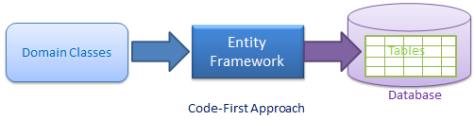
EF Core Code First Overview
EF Core Code-First is mainly useful in Domain Driven Design.
In the EF Core Code-First approach,
developer focus on the domain of application
EF Core creates the database and tables using Code-First Migration based on the default conventions and configuration based on the Domain classes.

Slide 6
Code-First Workflow
Step 1: Create or modify domain classes
Step 2: Configure these domain classes using Fluent-API or data annotation attributes
Step 3: Create database using automated migration

Slide 7
Code-First Workflow
Loop:
Step 2.x: Add or update the domain classes
Step 3.x: Update database schema using code first migration
End loop

Slide 8
Configuring EF Core
Section 2

Slide 9
Configuring EF Core
When the application’s DbContext is first used, EF Core sets off a process to configure itself and build a model of the database it’s supposed to access.
You can use three approaches to configure EF Core: By Convention, Data Annotations, and Fluent API.
Most real applications need a mixture of all three approaches to configure EF Core in exactly the way your application needs

Slide 10
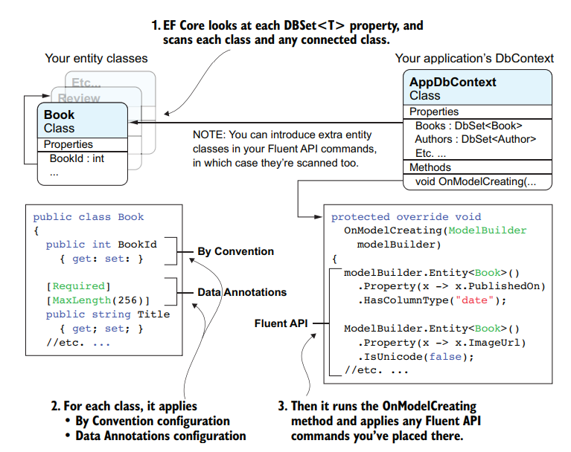
Configuring EF Core

Slide 11
FE Core Conventions
https://www.entityframeworktutorial.net/efcore/conventions-in-ef-core.aspx

Slide 12
Default Conventions in EF Core
EF Core uses a set of default conventions that determines how to map between our database and Domain classes
These conventions help us reduce the configuration code to achieve this mapping.

Slide 13
Default FE Core conventions (1)
Default Convention For | Description
Schema | By default, EF creates all the DB objects into the dbo schema.
Table Name | <Entity Class Name> + 's' EF will create a DB table with the entity class name suffixed by 's' e.g. Student domain class (entity) would map to the Students table.
Primary key Name | 1) Id 2) <Entity Class Name> + "Id" (case insensitive) EF will create a primary key column for the property named Id or <Entity Class Name> + "Id" (case insensitive).
Foreign key property Name | By default EF will look for the foreign key property with the same name as the principal entity primary key name. If the foreign key property does not exist, then EF will create an FK column in the Db table with <Dependent Navigation Property Name> + "_" + <Principal Entity Primary Key Property Name> e.g. EF will create Grade_GradeId foreign key column in the Students table if the Student entity does not contain foreignkey property for Grade.
Notes:
EF use Id column, then use <Entity Class Name> + "Id“ as a simple field

Slide 14
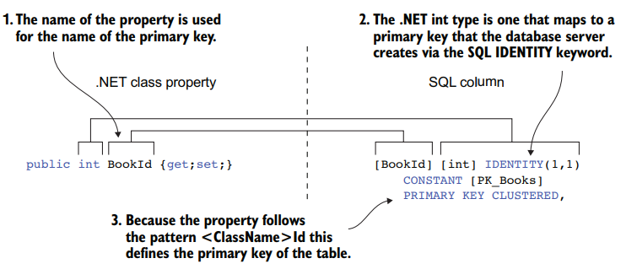
The primary-key By Convention mapping
the primary-key By Convention mapping between the .NET class and the SQL column

Slide 15
Default code first conventions (2)
Null column | EF creates a null column for all reference type properties and nullable primitive properties e.g. string, Nullable<int>, Student, Grade (all class type properties)
Not Null Column | EF creates NotNull columns for Primary Key properties and non-nullable value type properties e.g. int, float, decimal, datetime etc.
DB Columns order | EF will create DB columns in the same order like the properties in an entity class. However, primary key columns would be moved first.
Properties mapping to DB | By default, all properties will map to the database. Use the [NotMapped] attribute to exclude property or class from DB mapping.
Cascade delete | Enabled by default for all types of relationships.
EF6 One change in the default mapping conventions is that EF Core maps a .NET DateTime type to SQL datetime2(7), whereas EF6 maps .NET DateTime to SQL datetime.

Slide 16
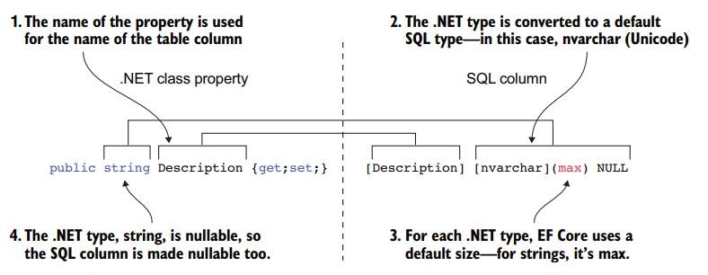
Convention rules to define an SQL column.
the application of the name, type, size, and nullability conventions applied to a property

Slide 17
Default code first conventions
Examples:
public string Description { get; set; } => mapped
public string Description { get { return Name; } } => not mapped
public string Description { set { value = Name; } } => not mapped
public string Description; => not mapped
private string Description { get; set; } => not mapped
protected string Description { get; set; } => not mapped

Slide 18
Data type mapped
C# Data Type | Mapping to SQL Server Data Type | C# Data Type | Mapping to SQL Server Data Type
int | int | byte | tinyint
string | nvarchar(Max) | short | smallint
decimal | decimal(18,2) | long | bigint
float | real | double | float
byte[] | varbinary(Max) | char | No mapping
datetime | datetime | sbyte | No mapping (throws exception)
bool | bit | object | No mapping

Slide 19
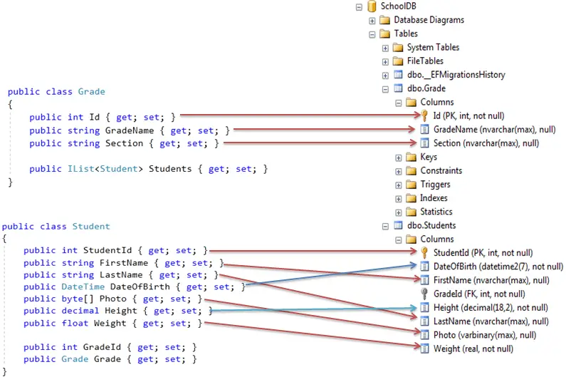

Example

Slide 20
Relationship Convention
EF core infers the One-to-Many, One-to-One relationship using the navigation property by default convention.
You need to configure them either using Fluent API or Data Annotation.
There are no default conventions available in Entity Framework Core which automatically configure a many-to-many relationship. You must configure it using Fluent API.

Slide 21
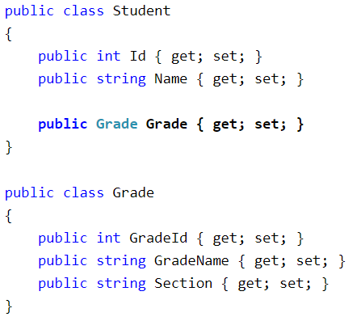
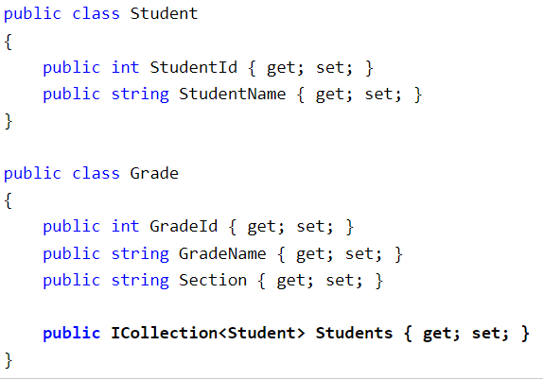
Conventions for One-to-Many Relationships (1)
Convention 1
Convention 2
includes a reference navigation property of parent in the child entity class
includes a collection navigation property of children in the parent entity class

Slide 22
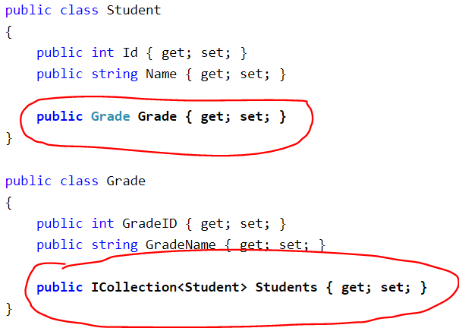
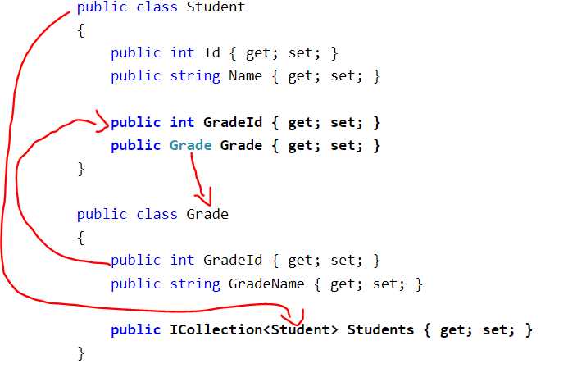
Conventions for One-to-Many Relationships (2)
Convention 3
Convention 4
includes navigation properties at both ends will also result in a one-to-many relationship (convention 1 + convention 2)
Defining the relationship fully at both ends with the foreign key property in the dependent entity creates a one-to-many relationship.

Slide 23
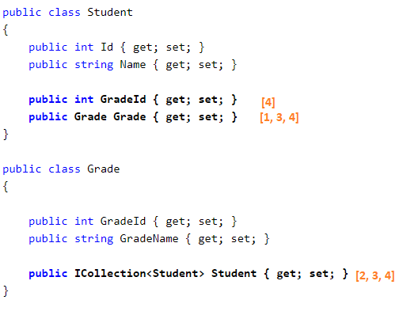

Conventions for One-to-Many Relationships

Slide 24
One-to-One Relationship Conventions
EF Core introduced default conventions which automatically configure a One-to-One relationship between two entities (EF 6.x or prior does not support conventions for One-to-One relationship).
a one-to-one relationship requires a reference navigation property at both sides

Slide 25
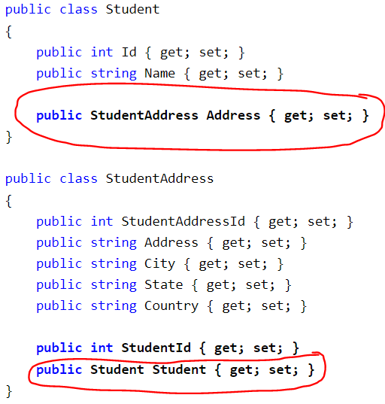
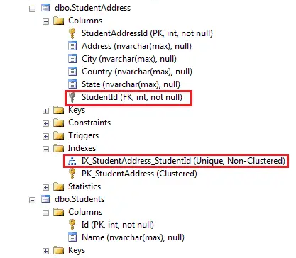
One-to-One Relationship Conventions

Slide 26
Database Initialization
Section 3

Slide 27
Database Initialization
The DBContext connects to the database using the Database Providers. These Providers requires a connection string to connect to the database.

Slide 28

Database Initialization
Once you install the database provider, then you can configure the database provider using the extension method provided them using the DbContextOptionsBuilder
For Example to use SQL Server install the package

Slide 29
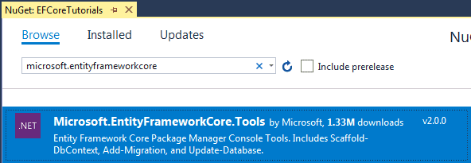
Database Initialization
In order to execute EF Core commands from Package Manager Console, search for the
Microsoft.EntityFrameworkCore.Tools package from NuGet UI and install it as shown below

Slide 30
Database Initialization Strategies
Section 4

Slide 31
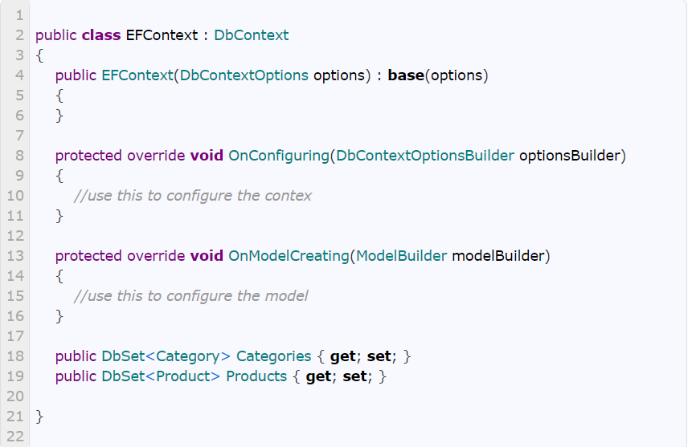
Create Class DBContext
To use DBContext, we need to create a context class and derive it from the DbContext base class
The following is the example of the Context class (EFContext):

Slide 32
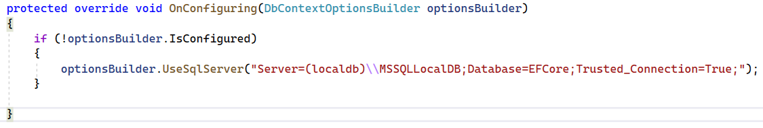
Adding a database provider
Then use the UseSqlServer extension method to register the SQL Server database provider
By overriding the OnConfigure method

Slide 33
Database Initialization
Start
Call constructor with connection string name?
Yes
Connection string name is existing in configuration file?
Yes
Check database is existing at connection?
Yes
Use existing database
No
No
No
Use context name as a connection string name
Create database at connection
Create database with the name matches to {Namespace}.{Context name} in local SQLEXPRESS

Slide 34
Seed Data
Section 5

Slide 35
Seed Data
To insert data into database tables during the database initialization process.
Use to provide some test data for the application
Use to create some default master data for the application

Slide 36
Seed Data steps
Step 1: Override the OnModelCreating method
protected override void OnModelCreating(ModelBuilder modelBuilder)
{
//Configure domain classes using modelBuilder here
}
Step 2: Reference to the EntityTypeBuilder
modelBuilder.Entity<T>()
Step 3: Use the HasData method to supply the list
modelBuilder.Entity<T>()
.HasData( new T())
Once you have added the initial data, you should use migrations to update the database

Slide 37
Summary
Use EF Code First approach: create entities class and DbContext first, then generate database
Code-First Conventions: EF uses conventions to create database, tables, columns
There are strategies to create database
Always consider to use appropriate strategy

Slide 38

Thank you

